Slide 1

Used car prediction using Machine Learning
Submitted by: Prathamesh Nayak

Slide 2

Used Car Price prediction
Due to the increased prices of new cars and the financial incapability of the customers to buy them, Used Car sales are on a global increase.
Existing System includes a process where a seller decides a price randomly and buyer has no idea about the car and its value in the present-day scenario.
In fact, seller also has no idea about the car’s existing value or the price he should be selling the car at

Slide 3
Problem Statement
The price of a new car in the industry is fixed by the manufacturer with some additional taxes.
With the covid 19 impact in the market, we have seen lot of changes in the car market.
In fact, seller also has no idea about the car’s existing value or the price he should be selling the car at.
Therefore, there is an Urgent Need For A Used Car Price Prediction System which effectively determines the worthiness of the car Using A Variety of Features.

Slide 4
Objective
To scrap used car data of at least 5000 cars from cardekho.com
To Analyze data to gain key insights about current used car market
To build Machine Learning model to predict price of used car.

Slide 5
DATASET Information
Dataset is Scrap from www.cardheko.com
Selenium webdriver is used to Scrape data of around 10000 cars
Raw data in excel file contain 10000 rows and 24 feature .
Dataset contain some errors, so data cleaning operation was performed.
Data integrity check is perform for missing values, duplicate data, data error.

Slide 6
Methodology of project
Phase 1 Web Scraping of Used Car Data from www.cardheko.com
Phase 2 Data cleaning, Data preprocessing on Raw data to create error-free, clean dataset.
Phase 3 EDA to gain key insight about used car market
Phase 4 Building Regression based Machine Learning price prediction model

Slide 7
Web Scraping Strategy
Phase 1 Web Scraping Strategy employed in this project as follow:
Selenium will be used for web scraping data from cardheko.com
In first part Scraping URL of Used car for different location in India.
Storing Scrap URL in excel file.
Selecting car feature to be scrap from website.
In second part Scraping data from individual URL in excel file.
Exporting final data in Excel file.

Slide 8
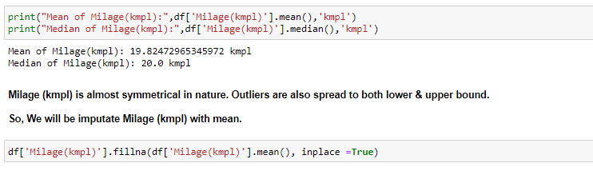
Missing Value imputation
After performing data cleaning operation, data for some of feature is missing.
Strategy for Handling missing data :
Imputation for categorical data done with mode of category
Numerical value can be imputed with mean or median depending on sensitive to outliers.

Slide 9
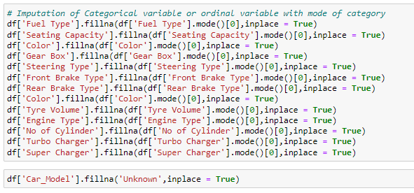
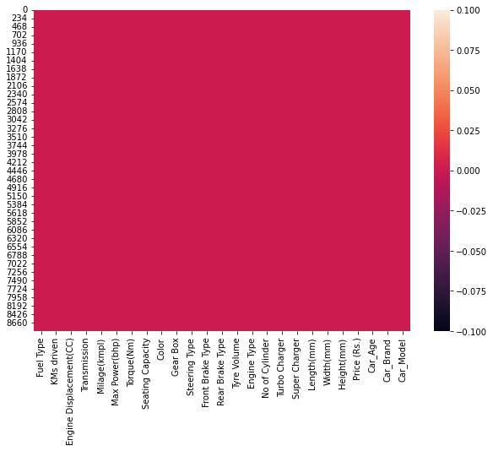
Missing Value imputation
Imputation of Missing Value for Categorical Variable
Heat map of Missing Value After Imputation

Slide 10
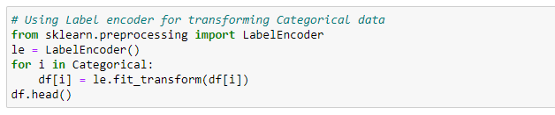
Label Encoding of categorical data
Categorical features are transform using label encoding.

Slide 11
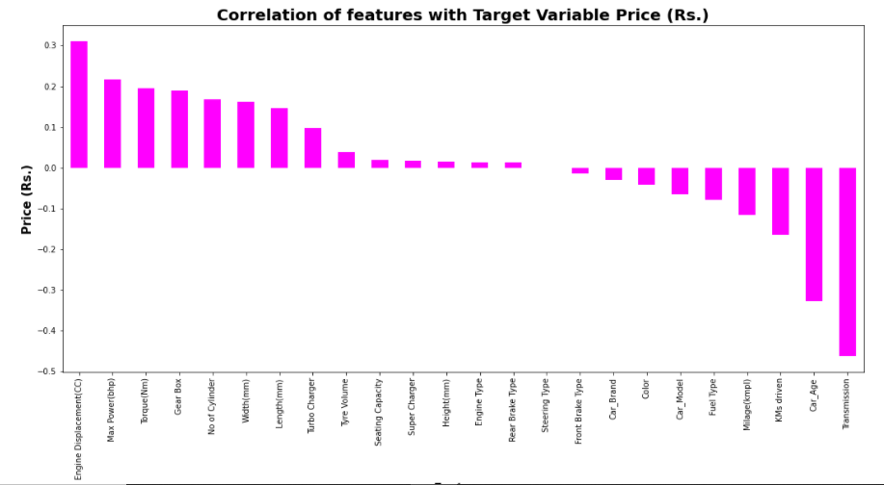
Data Inputs- Logic- Output Relationships
We can see most of feature are either poorly or moderately correlated with target variable Price.

Slide 12
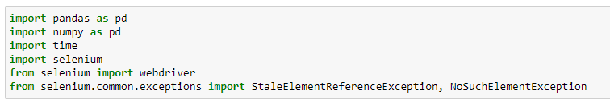
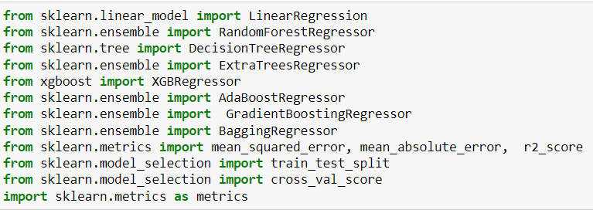
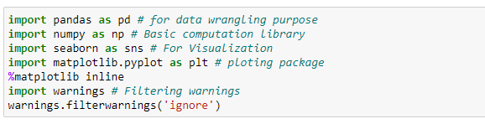
PYTHON Libraries USED IN THIS PROJECT
Different libraries used for web scraping Machine Learning model building libraries
Visualisation libraries used

Slide 13
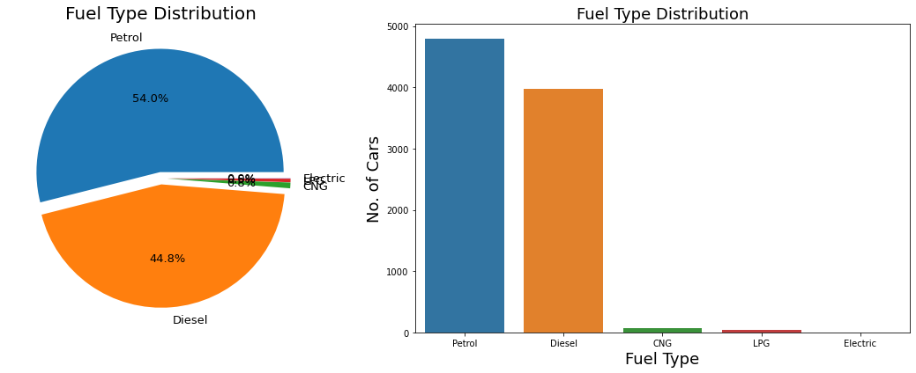
Exploratory Data Analysis
Fuel Type Distribution
Most of car are Petrol operated followed by Diesel. This may be due to low prices of Petrol car compare to diesel car.

Slide 14
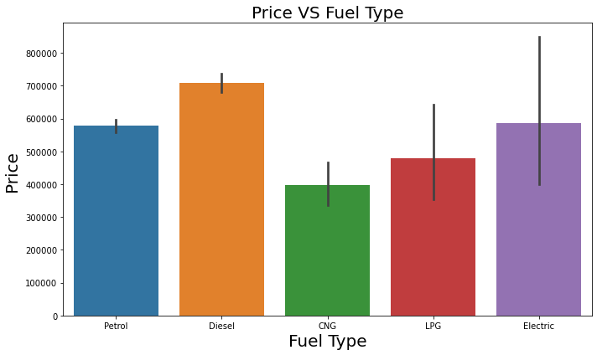
Exploratory Data Analysis
Price vs FUEL TYPE distribution
Very small segment of electric car and also price is quite high compared to petrol based.
CNG based car are Cheapest compare to others.

Slide 15
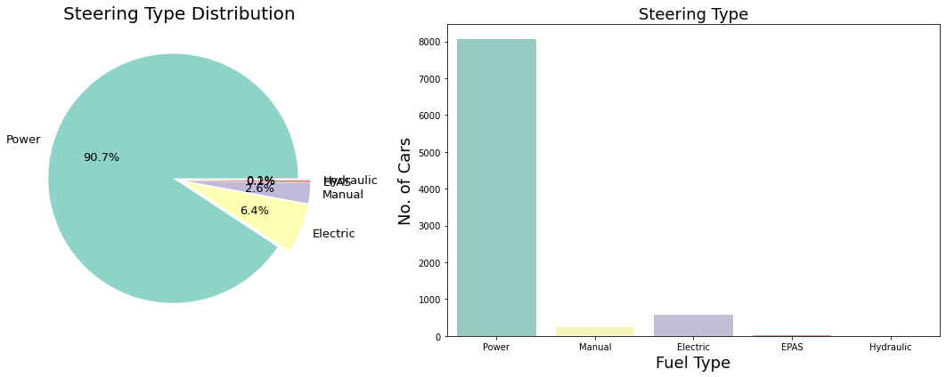
Exploratory Data Analysis
STEERING TYPE DISTRIBUTION
More than 90 % of car users prefer Power steering compares to others

Slide 16
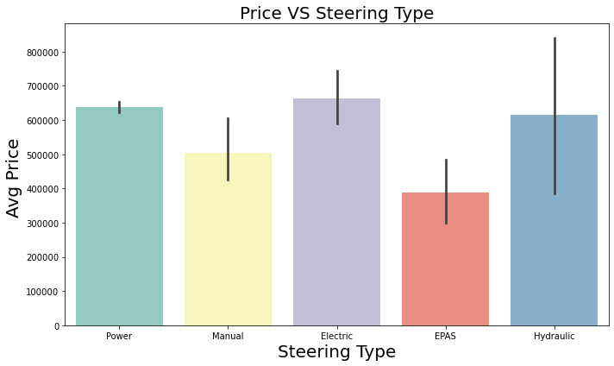
Exploratory Data Analysis
PRICE VS STEERING TYPE DISTRIBUTION
6.2% car based on electric steering, which is costly compare to others.
Very small section of car still uses Manual Steering, Most probably they belong to old model.

Slide 17
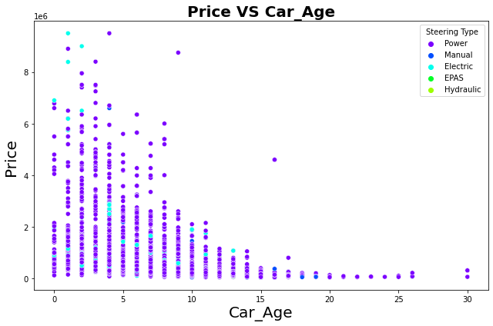
Maximum Number of loan taken VS Average payback time in last 30 days
Here we got confirmation of prediction in previous section, almost all manual steering-based car at least 10-year-old

Slide 18
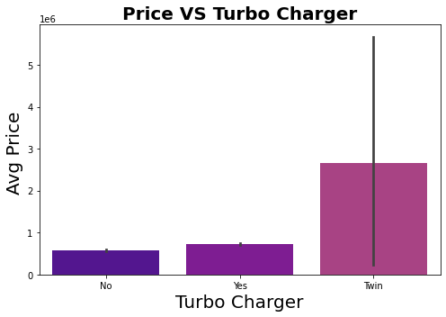
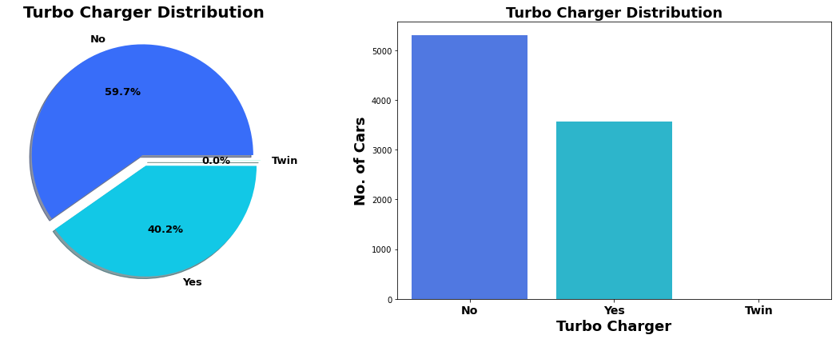
Turbocharger vs price
40% cars are with turbo charger & almost less than 1 % car with twin facility
As expected, Max price for car based on Twin engine followed by with turbocharger.

Slide 19
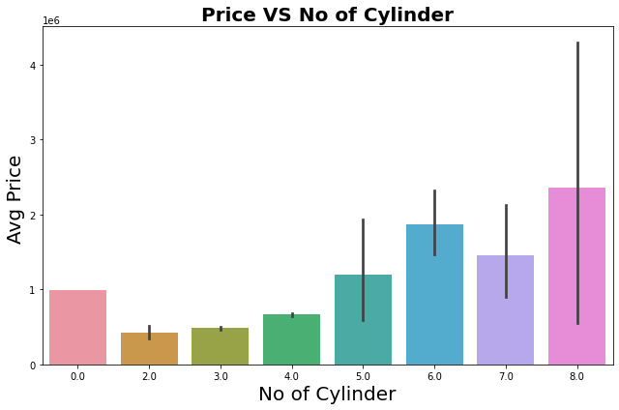
NO OF CYLINDER VS PRICE
From value counts we got information that most of Cars with are 4-cylinder engines followed by 3-cylinder engines.
In terms of Avg. Price as number of cylinders increases the average price increases.

Slide 20
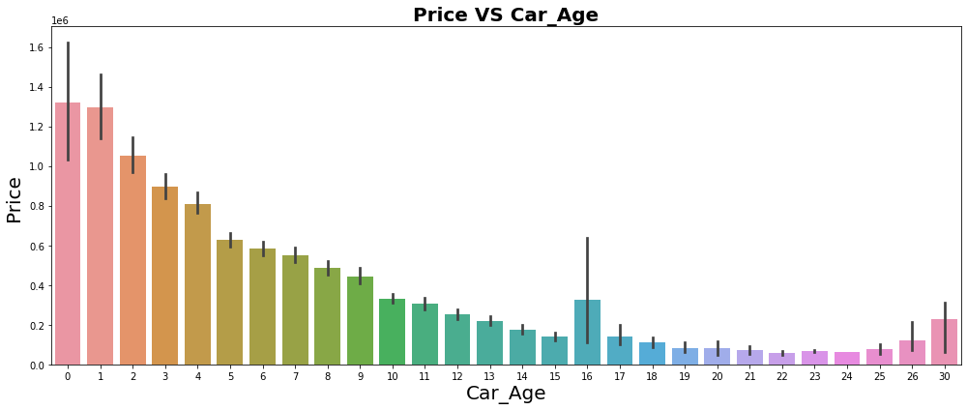
CAR AGE vs PRICE
As car get older, price of car deprecates

Slide 21
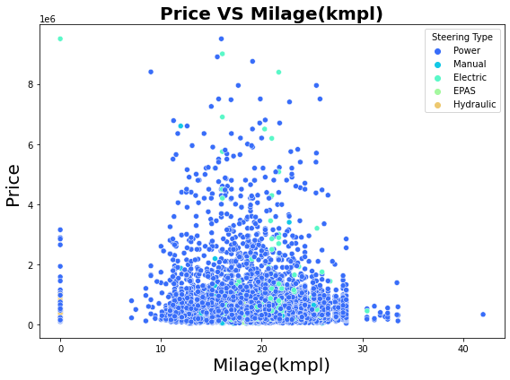
MILEAGE(KMPL) vs price
Milage (kmpl) varies in between 10 to 25 kmpl for most of cars. For Majority cars price is below 0.5e6.

Slide 22
MACHINE LEARNING MODEL BUILDING
Objective is to predict price of used car . It can be solve by application of regression ML algorithm.
Different Regression algorithm used to train model, in order build ML model with maximum R2 Score.
Machine learning classification algorithms used in this project are –
Random Forest Regressor
Decision Tree Regressor
XGB Regressor
Gradient Boosting Regressor
Bagging Regressor

Slide 23
KEY METRICS FOR SUCCESS IN SOLVING PROBLEM UNDER CONSIDERATION
Mean absolute error which gives magnitude of difference between the prediction of an observation and the true value of that observation.
Root mean square error is one of the most commonly used measures for evaluating the quality of predictions.
R2 score which tells us how accurate our model predict result, is going to important evaluation criteria along with Cross validation score.

Slide 24
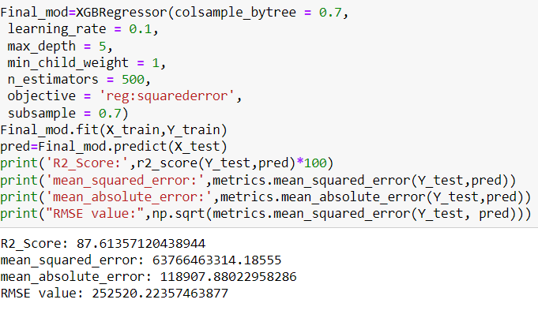
Hyper parameter tuned ML model
On Basis of difference between R2 Score and Cross Validation Score XGBRegressor is selected as best model

Slide 25
Limitations & Scope for Future OF THIS Work
Around data for more than 10000 car scrap from cardheko.com
We can scrap more data from different online platform like olx, car24. More data obviously means more accurate prediction.
Here we Scrap almost 24 features. But there are many different kinds of safety, comfort, entertainment features to which buyer weight while buying car. We can also include such more feature in future.

